Slide 1
Data Analytics Internship Portfolio
Name: G. Akshitha
Organization: ApexPlanet Software Pvt. Ltd. Role: Data Analytics Intern
Year: 2026

Slide 2
Internship Overview
Objective:
To gain hands-on experience in data cleaning, analysis, visualization, dashboard creation, and statistical validation using real-world datasets.
Tools Used:
Python
Pandas
NumPy
SQL
MySQL
Power BI
Jupyter Notebook
GitHub

Slide 3
Task 1 — Data Immersion & Wrangling
Activities performed:
Loaded the dataset into Jupyter Notebook.
Checked data types and dataset structure.
Handled missing values.
Removed duplicate records.
Standardized date formats.
Created a cleaned dataset for analysis.
Deliverables:
Cleaned Dataset
Data Dictionary
Jupyter Notebook

Slide 4
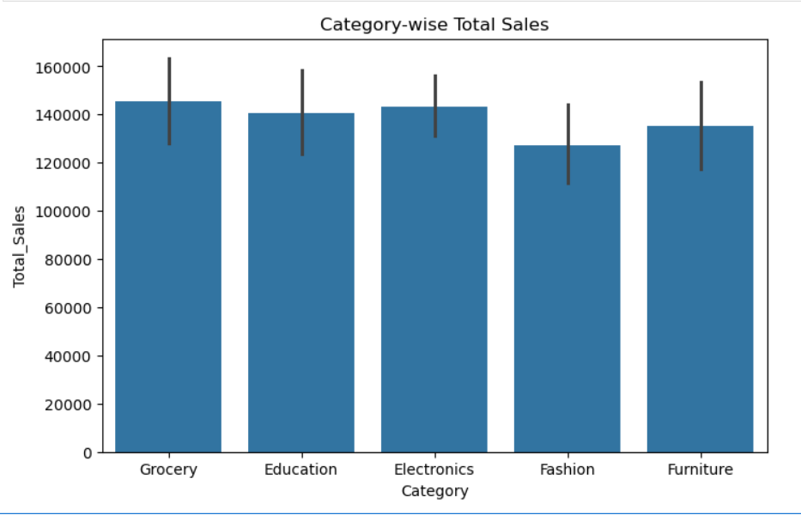
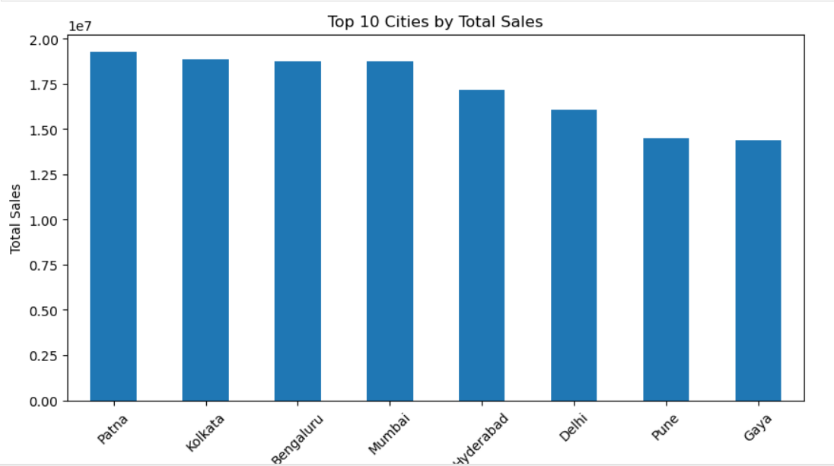
Task 2: Exploratory Data Analysis & Business Intelligence
Analysis performed:
Calculated total revenue.
Calculated average order value.
Identified top-selling categories.
Identified top-performing cities.
Key Insights:
Total Revenue: 139,399,439.65
Total Orders: 992
Average Order Value: 139,399.44
Top Category: Electronics
Top City: Patna

Slide 5
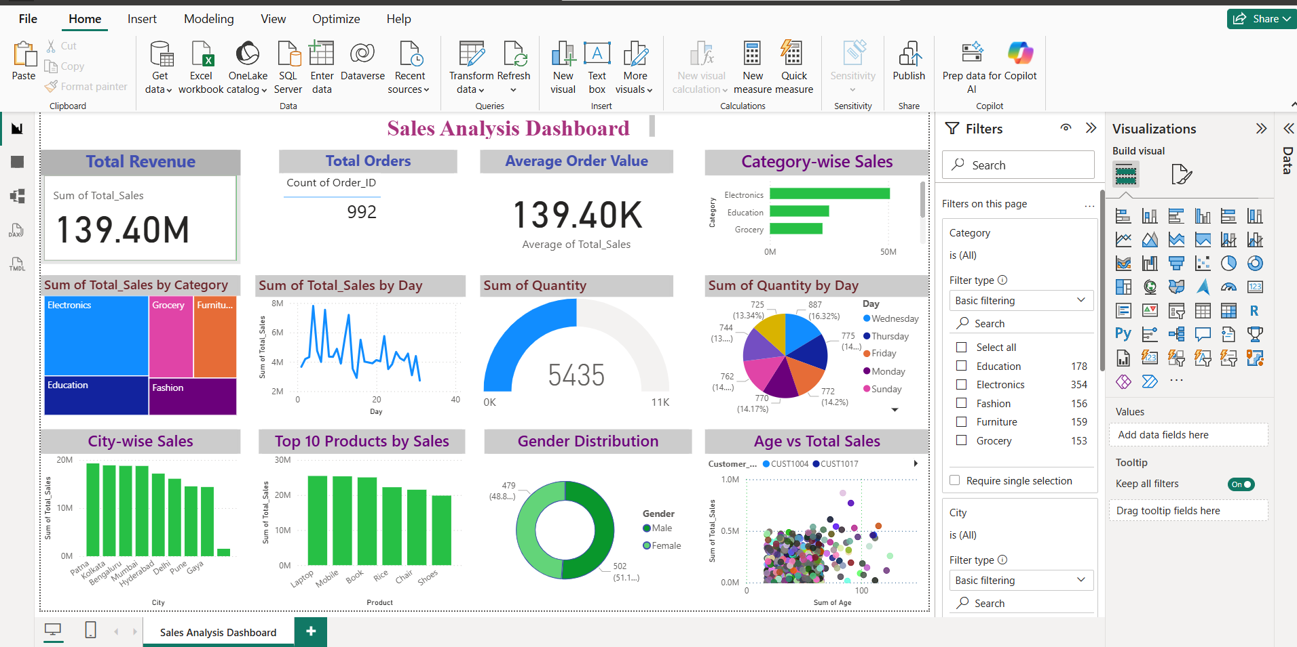
Task 3: Deep-Dive Analysis & Interactive Dashboarding
Dashboard Features:
KPI Cards
Category-wise Sales Analysis
Top Products Analysis
Customer Insights
Interactive Filters
Tools Used:
Power BI

Slide 6
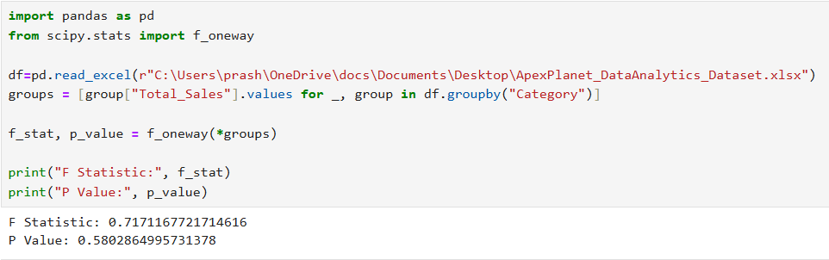
Task 4 — Data Storytelling & Statistical Validation
Hypothesis Testing:
Null Hypothesis (H₀):
There is no significant difference in average sales among categories.
Alternative Hypothesis (H₁):
There is a significant difference in average sales among categories.
Results:
F Statistic: 0.7171
P Value: 0.5803
Conclusion:
Since P > 0.05, we fail to reject the null hypothesis.

Slide 7
Technical Skills Acquired
Programming:
Python
SQL
Skills:
Data Cleaning
Data Visualization
Business Intelligence
Dashboard Development
Statistical Analysis
Tools:
MySQL
Power BI
Jupyter Notebook
GitHub
Libraries:
Pandas
NumPy
Matplotlib
Seaborn

Slide 8
Conclusion
This internship provided practical experience in data analytics, business intelligence, and data storytelling. Through these tasks, I improved my analytical, technical, and problem-solving skills and gained hands-on experience with industry tools.

Slide 9
Thank You!
Name: G. Akshitha
Email: g.akshitha5123@gmail.com
GitHub: Akshitha0312

